Slide 1
Reliable & Unreliable Sources

Slide 2
What is a reliable & unreliable source?
Reliable sources are written by experts in the field.
Unreliable sources are written by authors who may not have a thorough understanding of the topic or content or who may have biased views; many sources may not even list an author or author names and you need to be wary of these.

Slide 3
Examples of Reliable Sources
Books
Newspapers and magazines (be careful with these; some are biased)
Peer reviewed journals & articles
Dissertations and Masters Thesis
Scholarly articles
Educational institutions and their websites (.edu)
Government institutions and their websites (.gov)
Non-profits (be careful) (.org)

Slide 4
Examples of Unreliable Sources
Wikipedia: A good place to start to get some information, but probably not to cite
Blogs (unless they come from well established experts)
Personal Websites
For profit websites
Tweets
Social media (Facebook, TikTok, Instagram, etc.)
Self-published websites and sources
Editorials (usually these are opinionated)
Some News Websites
Organizations that have biases or agendas

Slide 5
Questions
Is the source written by a qualified person or people with credentials?
Who is intended audience for the source?
Does the information in the source contain facts, opinion, or propaganda?
Does the source contain in-text citations and a reference list or works cited page? If it is an online article, are the sources linked within the paragraphs?
Is the source a peer-reviewed source? (You might have to learn more about the source to determine whether it is peer-reviewed.)
Is the site the actual site or meant to look like the actual site (cnn.com vs. cnsnews.com)

Slide 6
Let’s Test Your Knowledge

Slide 7
Reliable or Unreliable: What do you think?

Slide 8
Answer: Unreliable
Website such as shmoop and other similar sites such as spark notes, and cliff notes do not rely on credible authors for their information and rarely provide support for way they write.

Slide 9
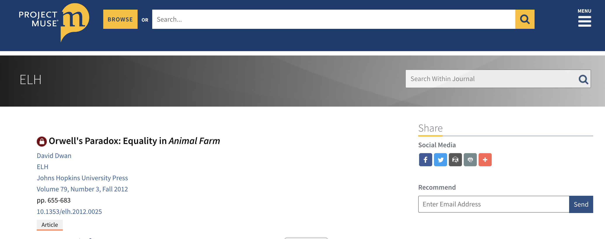
Reliable or Unreliable: What do you think?

Slide 10
Answer: Reliable
Project Muse is a database that houses peer-reviewed scholarly research.
All of the journal articles here are written by credible authors and go through a peer review process.
The articles contain links connecting ideas to other credible sources.

Slide 11
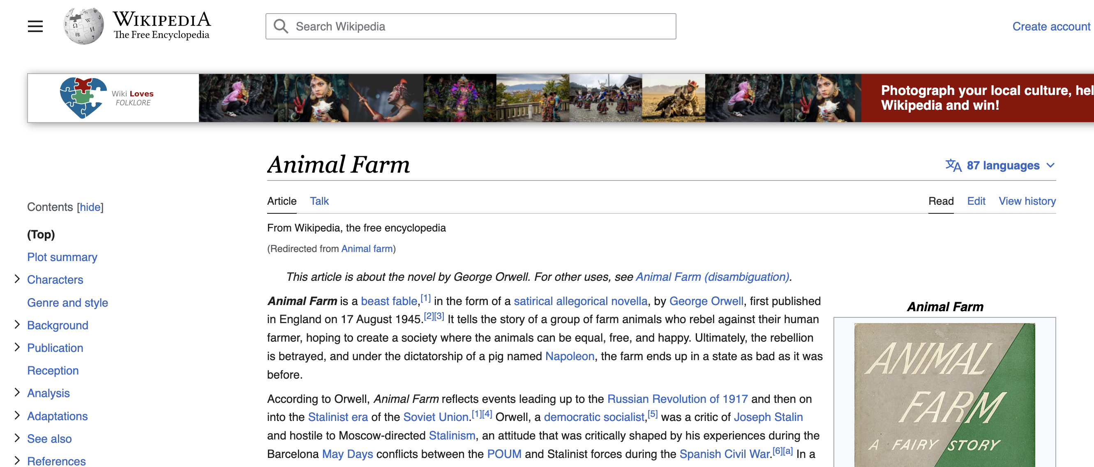
Reliable or Unreliable: What do you think?

Slide 12
Answer: Unreliable
Wikipedia is a site where anyone can add any information.
It is a good place to get some general knowledge that may help with further searching/research, but it is not a reliable source to site in a paper.

Slide 13
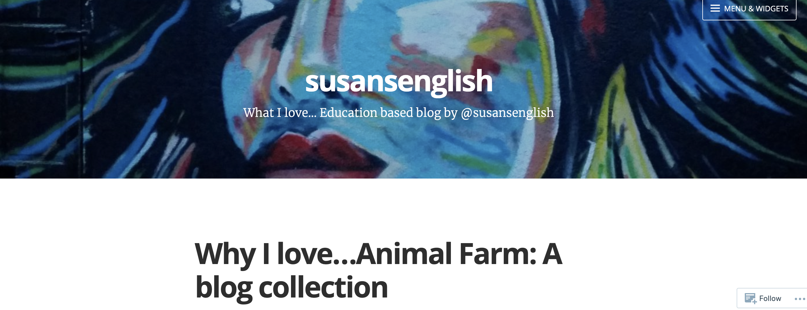
Reliable or Unreliable: What do you think?

Slide 14
Answer: Unreliable
Personal blogs are not reliable sources of information.
They typically do not contain links to research that supports their assertions.
Usually people writing personal blogs are not authorities.

Slide 15
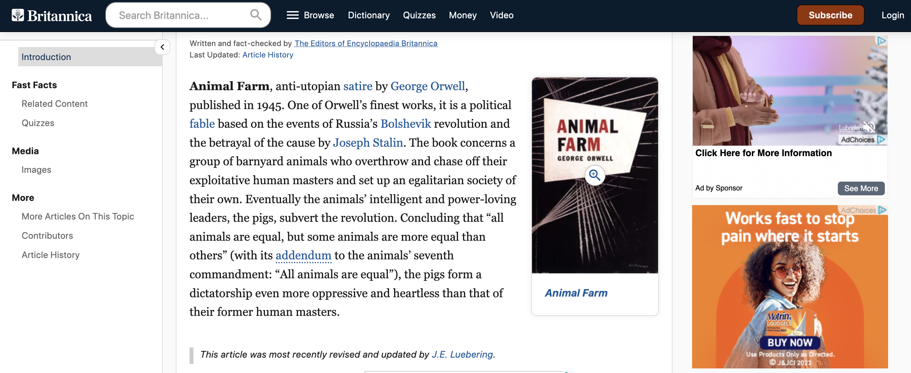
Reliable or Unreliable: What do you think?

Slide 16
Answer: Reliable
Britannica library has been around a long time.
The site contains objective information that is fact-checked written by experts in the field.
Their information is also vetted through an editorial process.

Slide 17
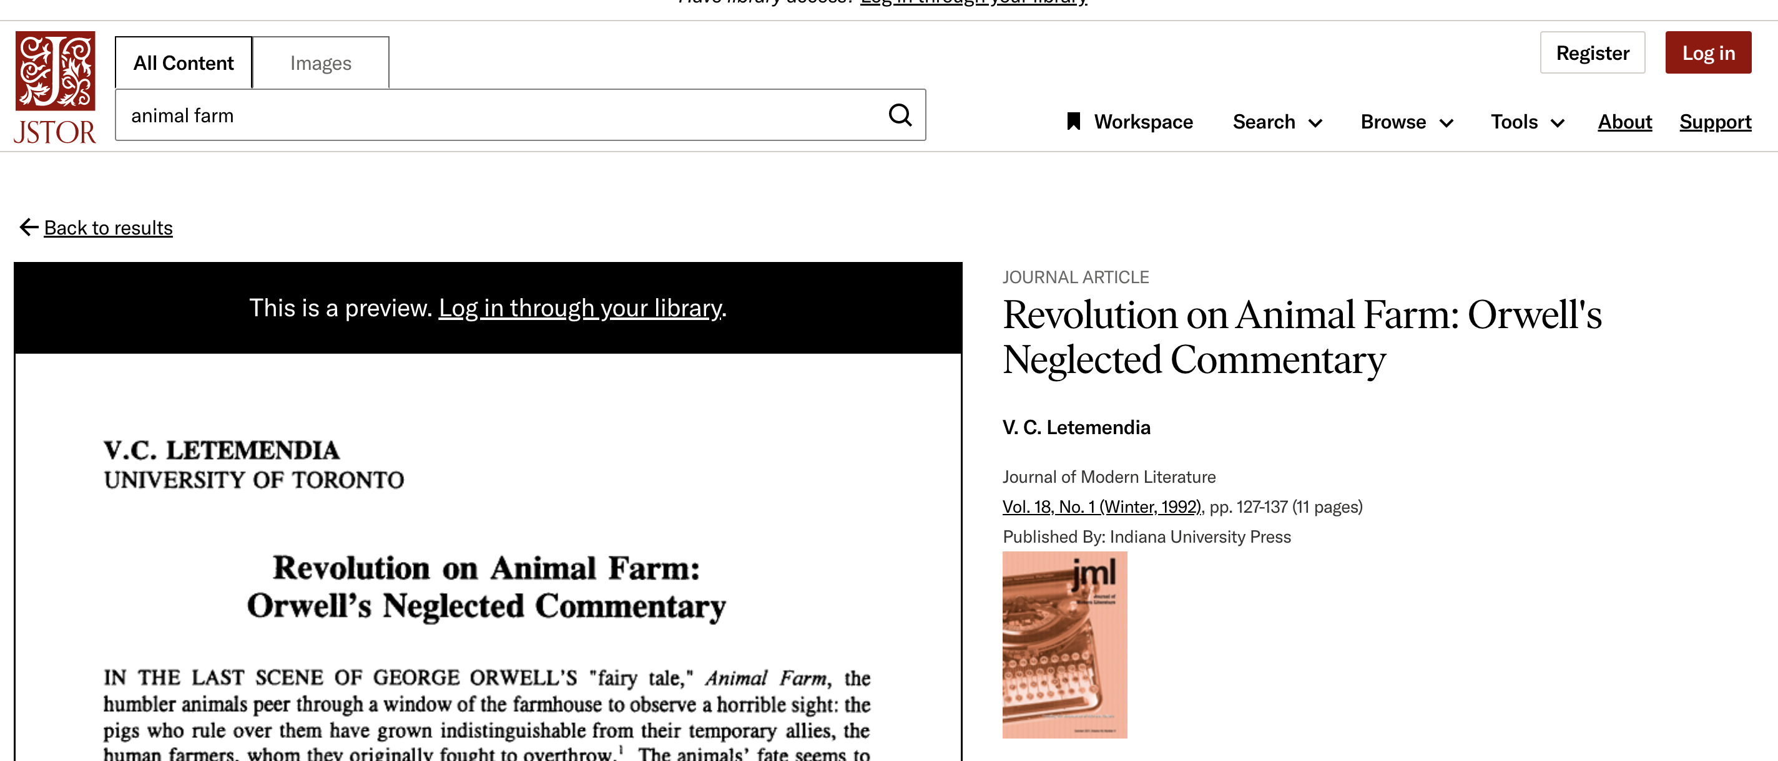
Reliable or Unreliable: What do you think?

Slide 18
Answer: Reliable
JSTOR is another searchable database that only contain peer-reviewed scholarly journals.
You can rely on most searchable databases that you find at a library (EBSCO, ERIC, etc.)

Slide 19
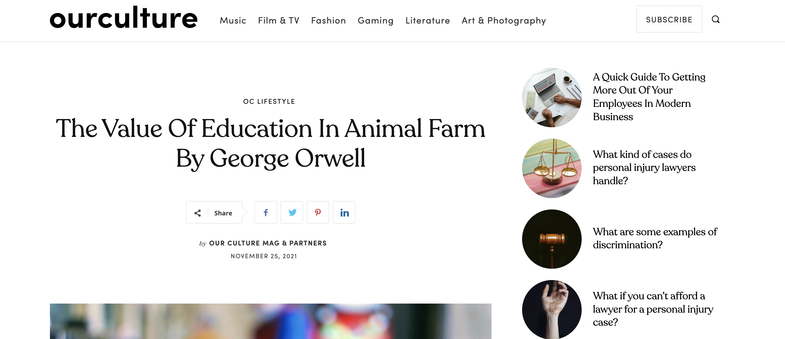
Reliable or Unreliable: What do you think?

Slide 20
Answer: Unreliable
This site appears to be an online magazine that reports on many topics.
When looking at this particular article, however, there is no author listed. If you search further into the article, there are no links to outside information.
If you read the article, you’ll see that the article discusses main points of an essay from Wayne State University. Thus, it is not a primary source; the authors are merely distilling information. It would be best to search the original essay.

Slide 21
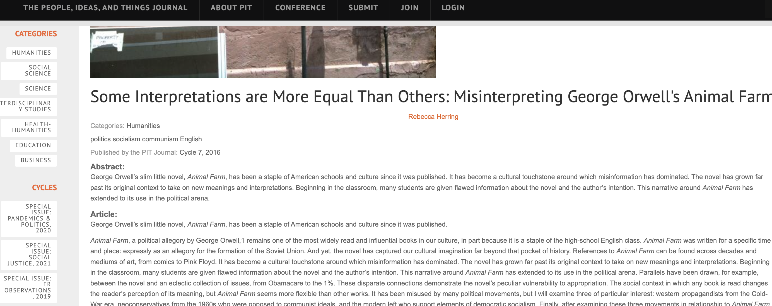
Reliable or Unreliable: What do you think?

Slide 22
Answer: Unreliable
At first glance, this site/journal looks reliable. However, when you dig a bit deeper to learn more about the site, you discover it is from UNC and relies on undergraduate students for peer-review and “peer-sourcing.”
The authors are not authorities on the topics; the are undergraduate students.

